Slide 1
Amazon web Services…
Presented by-
Manisha Modi & Shruti Jamgade

Slide 2
Introduction to Amazon Elastic Compute Cloud (EC2)
Amazon Elastic Compute Cloud (Amazon EC2) provides scalable computing capacity in the Amazon Web Services (AWS) cloud.
Using Amazon EC2 eliminates your need to invest in hardware up front, so we can develop and deploy applications faster.
Amazon EC2 enables you to scale up or down to handle changes in requirements .
Amazon EC2 Container Service (ECS) is a highly scalable, high performance container management service that supports Docker containers and allows you to easily run applications on a managed cluster of Amazon EC2 instances.

Slide 3
Features of Amazon EC2
Virtual computing environments, known as instances.
Secure login information for your instances using key pairs .
A firewall that enables you to specify the protocols, ports, and source IP ranges that can reach your instances using security groups.

Slide 4
Introduction to Amazon Simple Storage Service (S3)
Amazon S3 has a simple web services interface that you can use to store and retrieve any amount of data, at any time, from anywhere on the web.
Amazon S3 provides a REST and a SOAP interface.
The REST API is an HTTP interface to Amazon S3. Using REST, you use standard HTTP requests to create, fetch, and delete buckets and objects.
Amazon S3 charges you only for what you actually use, with no hidden fees and no overage charges.

Slide 5
Amazon Relational Database Service (Amazon RDS)
Amazon Relational Database Service (Amazon RDS) is a web service that makes it easier to set up, operate, and scale a relational database in the cloud.
It provides cost-efficient, resizable capacity for an industry-standard relational database and manages common database administration tasks.
Amazon RDS manages backups, software patching, automatic failure detection, and recovery.

Slide 6
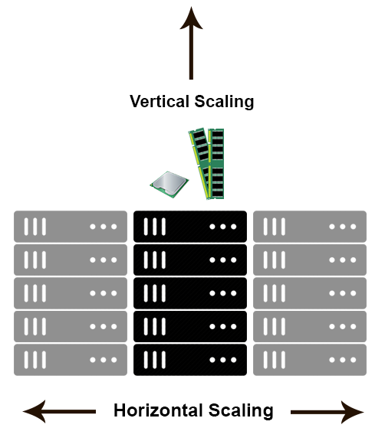
Scaling in AWS..
Horizontal scaling means that you scale by adding more machines into your pool of resources
Vertical scaling means that you scale by adding more power (CPU, RAM) to an existing machine.

Slide 7
Amazon Route 53
Amazon Route 53 to help you get a website or web application up and running.
Amazon Route 53 effectively connects user requests to infrastructure running in AWS
Amazon Route 53 performs three main functions:
- Register domain names.
- Route Internet traffic to the resources for your domain .
- Check the health of your resources .

Slide 8
Introduction to AWS Identity and Access Management (IAM)
AWS Identity and Access Management (IAM) enables you to securely control access to AWS services and resources for your users.
Using IAM, you can create and manage AWS users and groups, and use permissions to allow and deny their access to AWS resources.
IAM is a feature of your AWS account offered at no additional charge. You will be charged only for use of other AWS services by your users.

Slide 9
Deployment & Management
AWS Code Deploy is a deployment service that automates application deployments to Amazon EC2 instances or on-premises instances in your own facility.
AWS Code Deploy works with various systems for configuration management, source control, continuous integration, continuous delivery, and continuous deployment.

Slide 10
Thank You…..

